Slide 1
Amazon Sales Data Analysis Using MySQL.

Slide 2
Project Objective
The major aim of this project is to gain insight into Amazon's sales data to understand the different factors that affect sales in other branches.
Analysis List
Product Analysis
Analyze the data to understand the different product lines, the product lines performing best, and the ones that need improvement.
Sales Analysis
This analysis aims to answer the question of the sales trends of products. The result of this can help us measure the effectiveness of each sales strategy the business applies and what modifications are needed to gain more sales.
Customer Analysis
This analysis aims to uncover the different customer segments, purchase trends and the profitability of each customer segment.

Slide 3
Data set provided
Columns | Description | Data Type
invoice_id | Invoice of the sales made | VARCHAR(30)
branch | Branch at which sales were made | VARCHAR(5)
city | The location of the branch | VARCHAR(30)
customer_type | The type of the customer | VARCHAR(30)
gender | Gender of the customer making purchase | VARCHAR(10)
product_line | Product line of the product sold | VARCHAR(100)
unit_price | The price of each product | DECIMAL(10, 2)
quantity | The amount of the product sold | INT
VAT | The amount of tax on the purchase | FLOAT(6, 4)
total | The total cost of the purchase | DECIMAL(10, 2)
date | The date on which the purchase was made | DATE
time | The time at which the purchase was made | TIMESTAMP
payment_method | The total amount paid | DECIMAL(10, 2)
cogs | Cost Of Goods sold | DECIMAL(10, 2)
gross_margin_percentage | Gross margin percentage | FLOAT(11, 9)
gross_income | Gross Income | DECIMAL(10, 2)
Rating | Rating | FLOAT(2, 1)

Slide 4
Data wrangling
Building database
Creating a table and inserting the data
Checking null value

Slide 5
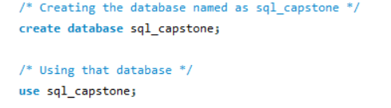
Creating DB and using the created DB
We are creating a database named “sql_capstone”, and using it using USE() function.

Slide 6
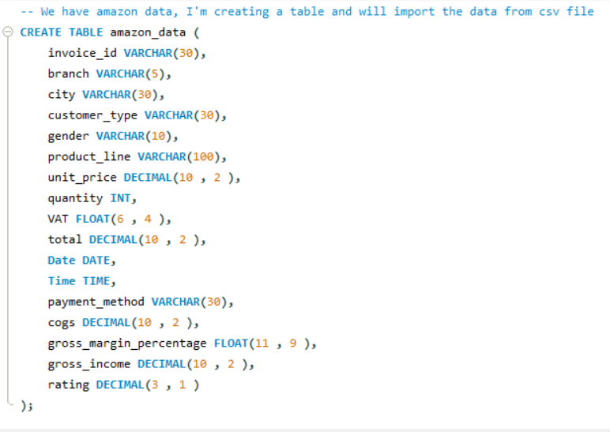
Creating table structure

Slide 7
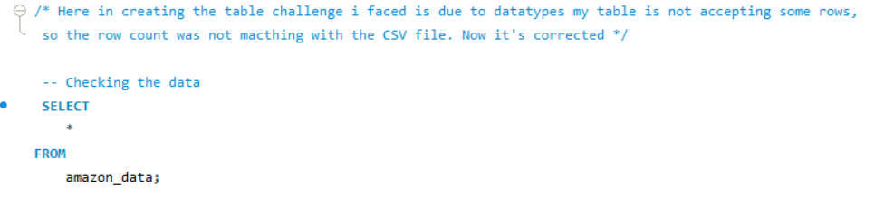
Checking all the data in table after importing

Slide 8
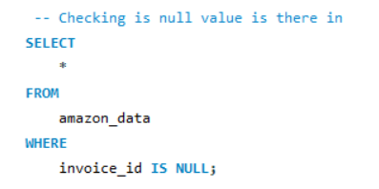
Checking if there is any null value
We have confirmed from Odin School that the dataset has no null values.

Slide 9
Feature Engineering
Add a new column named Time of Day to give insight into Morning, Afternoon, and Evening sales. This will help answer the question of which part of the day most sales are made.
Add a new column named DayName that contains the extracted days of the week on which the given transaction took place (Mon, Tue, Wed, Thur, Fri). This will help answer the question of which week of the day each branch is busiest.
Add a new column named Month_Name that contains the extracted months of the year on which the given transaction took place (Jan, Feb, Mar). Help determine which month of the year has the most sales and profit.

Slide 10
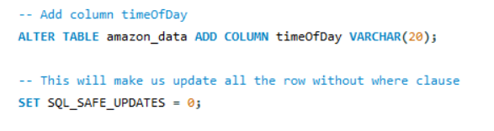
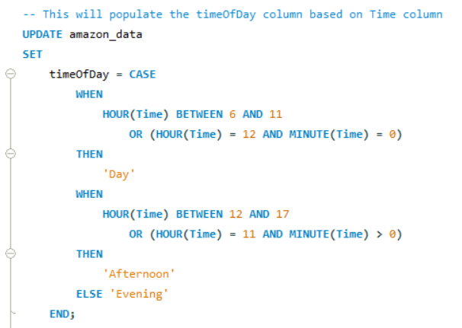
Adding new column time of day
This new column will tell if the time is in the Day, Afternoon, or evening
The values populates in timeOfDay column according to the “Time” column present in the table.

Slide 11
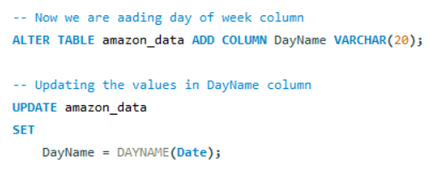
Adding new column day of the week
This will create a new column named “DayName” which will have names of the day in a week using DAYNAME()
function

Slide 12
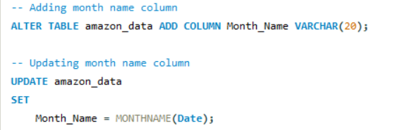
Adding new column month name
We are creating a “Month_Name” column which will have the values as month names
extracted from the date column using the MONTHNAME() function.

Slide 13
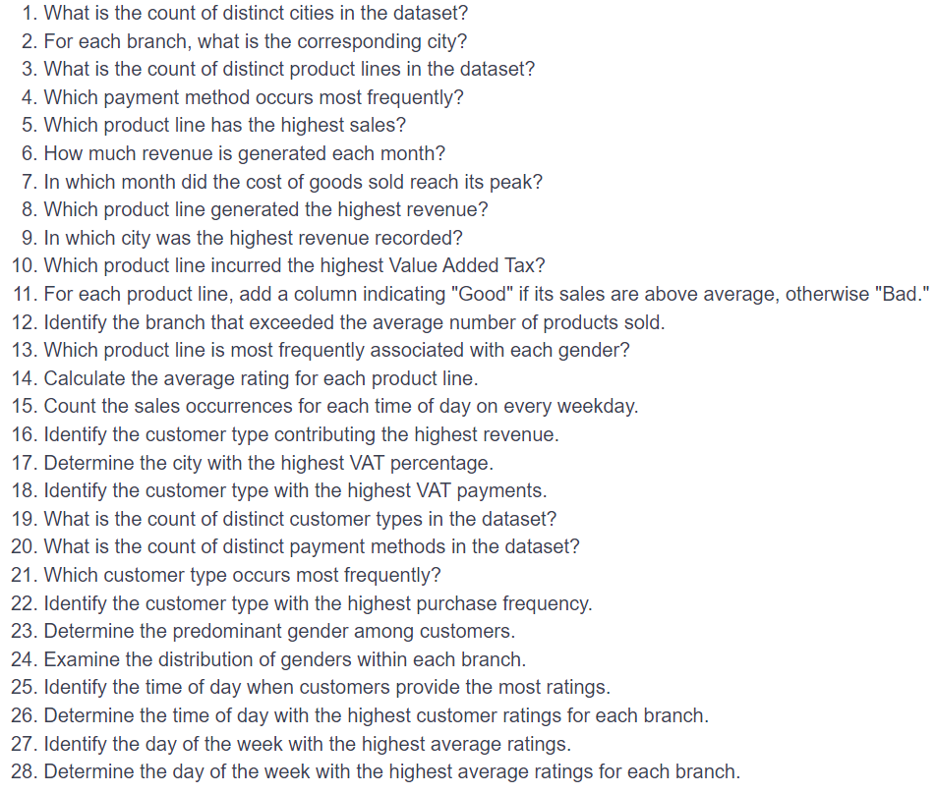
Now we’ll see some business queries

Slide 14
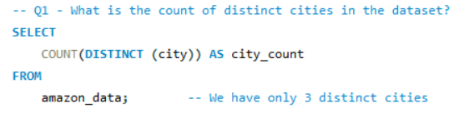

Query ->
Output ->
Comment -> We can see that only 3 cities are in the dataset.

Slide 15
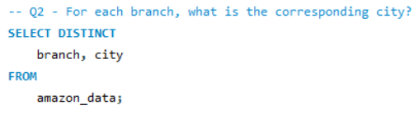
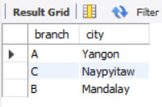
Query ->
Output ->
Comment -> For branch A -> Yangon, branch B -> Mandalay, C -> Naypyitaw

Slide 16
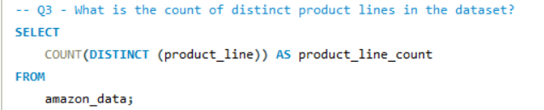

Query ->
Output ->
Comment-> We have 6 distinct product line

Slide 17
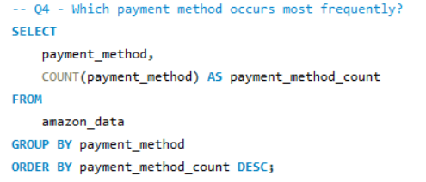
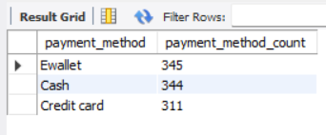
Query ->
Output ->
Comment-> As per the output “Ewallet” payment method occurs most frequently

Slide 18
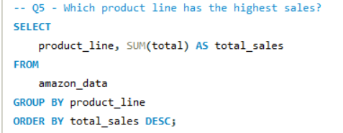
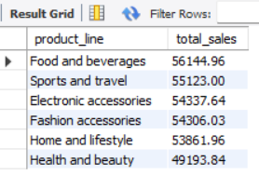
Query ->
Output ->
Comment-> Food and beverages product line has the highest sales

Slide 19
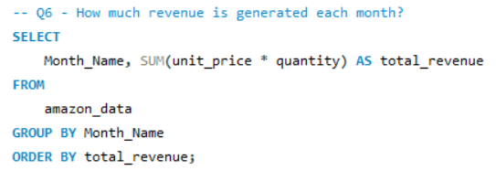
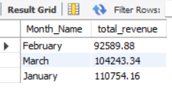
Query ->
Output ->
Comment-> In February -> 92589.83 In March -> 104243.34 In January -> 110754.16

Slide 20
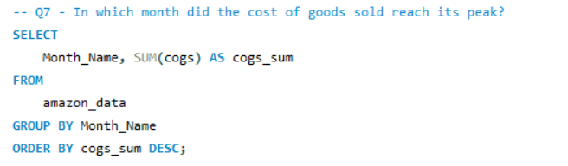
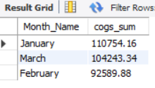
Query ->
Output ->
Comment-> In February -> 92589.83 In March -> 104243.34 In January -> 110754.16

Slide 21
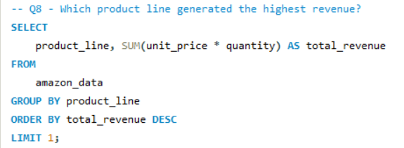

Query ->
Output ->
Comment-> Food and beverages product line has the highest revenue of 53471.28

Slide 22
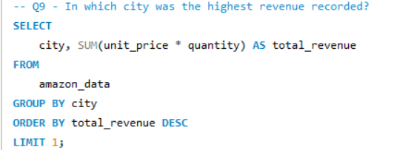

Query ->
Output ->
Comment-> City Naypitaw has the highest total revenue of 105303.53

Slide 23
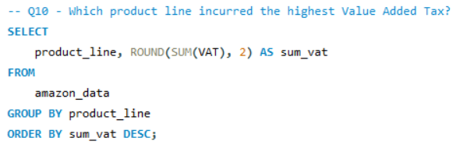
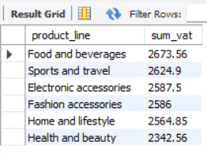
Query ->
Output ->
Comment-> Food and beverages product line has the highest VAT of 2673.56

Slide 24
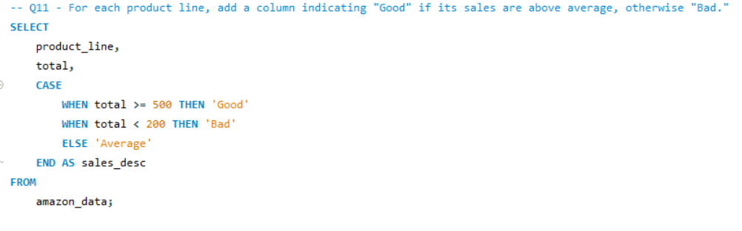
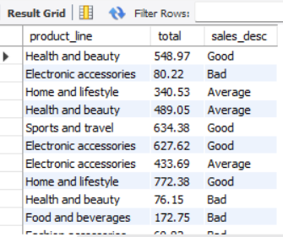
Query ->
Output ->
Comment-> Each product line has different sales description depending on total sales

Slide 25
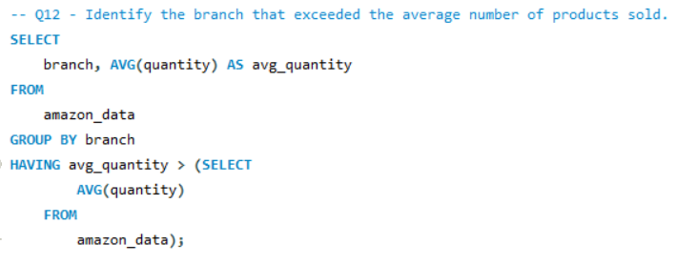

Query ->
Output ->
Comment-> Branch C has exceeded the average number of product sold

Slide 26
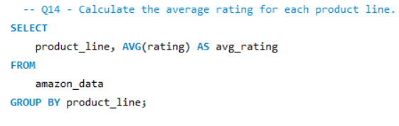
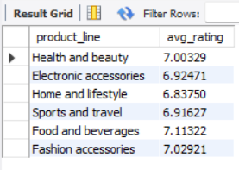
Query ->
Output ->
Comment-> In output we can see the average rating for each product line and food and beverages
has more average ratings than others.

Slide 27
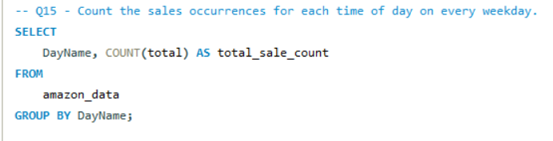
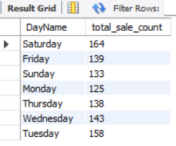
Query ->
Output ->
Comment-> In output we can see the total sales count on each weekday and Saturday
we have maximum number of sales occurrences.

Slide 28
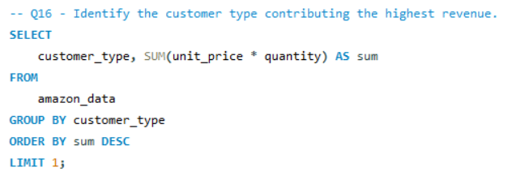

Query ->
Output ->
Comment-> Member customer type contributing the maximum revenue of 156403.28

Slide 29
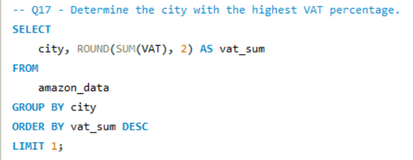

Query ->
Output ->
Comment-> City Naypitaw has the highest VAT percentage of 5265.18

Slide 30
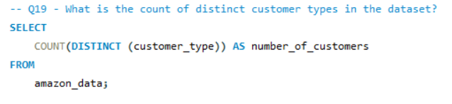

Query ->
Output ->
Comment-> Only 2 customer types we have in our dataset

Slide 31
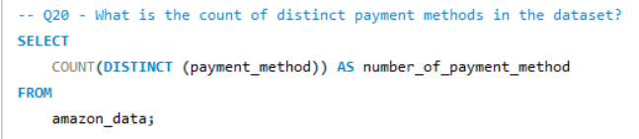

Query ->
Output ->
Comment-> We have 3 types of payment method

Slide 32
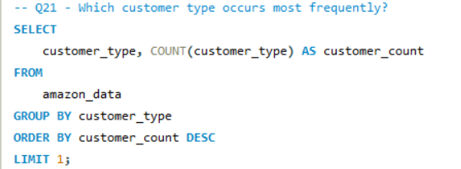

Query ->
Output ->
Comment-> Member customer type occur most frequently

Slide 33
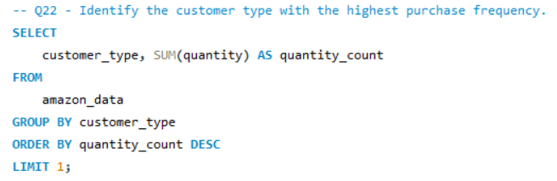

Query ->
Output ->
Comment-> Member customer type has the highest purchase frequency.

Slide 34
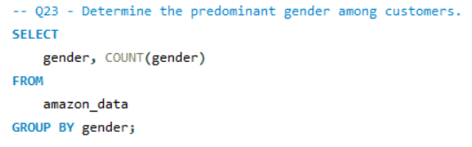
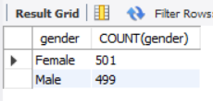
Query ->
Output ->
Comment-> Females count – 501, Male count - 499.

Slide 35
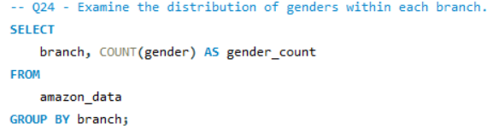
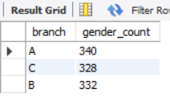
Query ->
Output ->
Comment-> Branch A – 340, Branch B – 332, Branch C – 328.

Slide 36
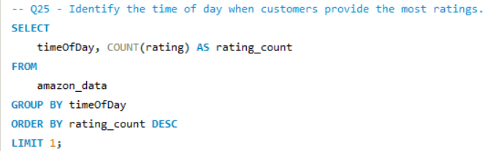
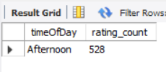
Query ->
Output ->
Comment-> In the Afternoon ratings are provided the most.

Slide 37
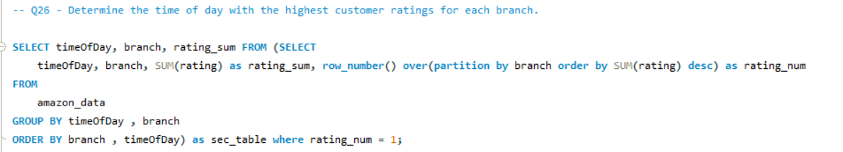
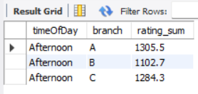
Query ->
Output ->
Comment-> For branch A rating_sum -> 1305.5, For branch B rating_sum -> 1102.7, For branch C rating_sum -> 1284.3

Slide 38
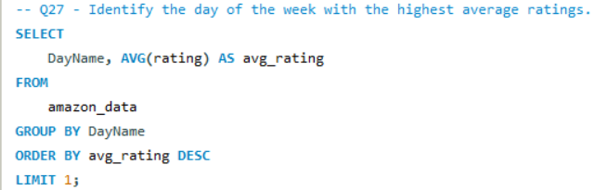

Query ->
Output ->
Comment-> On Monday the highest average rating is 7.15360

Slide 39
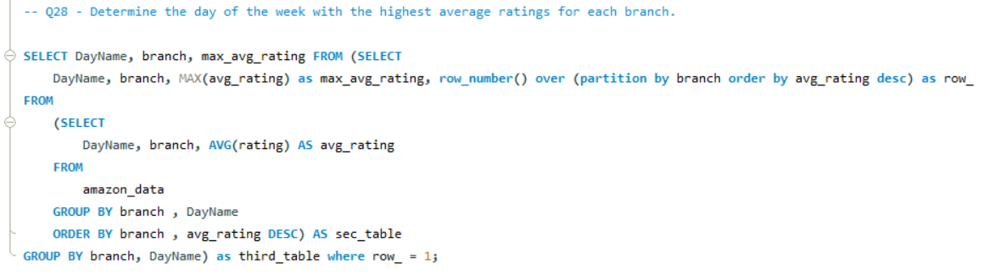
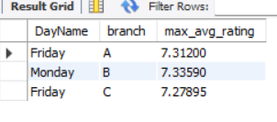
Query ->
Output ->
Comment-> On Friday in branch A, the maximum average rating is 7.31200 On Monday in branch B, the maximum average rating is 7.33590 On Friday in branch C, the maximum average rating is 7.27895

Slide 40
Insights
Product Analysis:-
6 Different product lines
Food and beverages performed well and Health and beauty need to be improved.
The food and beverages product line has the highest average rating.
Customer analysis:-
Member customer type contributes highly to revenue with the most purchase frequency.
In the afternoon, the customer provides the most ratings.
Females are the predominant gender among customers.
Sales Analysis:-
Ewallet payment method occurred most frequently
In January, in the city of Naypitaw, the highest revenue and COGS were recorded.
On Saturday, a maximum no. of sales occurred.
On Monday, for branch “B” maximum average rating given, and Branch “B” associated with city Mandalay.

Slide 41
Thank you.

